Slide 1
Numpy, Pandas, Matplotlib
Willard Williamson
Adjunct Professor
iSchool, Syracuse University
linkedin.com/in/ncc-1701-d
Notes:
Explain Python’s place in big data. It’s the the go-to language besides Java / Scala. We’ll use python to write map-reduce programs as well as part of Spark Programming.

Slide 2
More Information
Pandas: http://pandas.pydata.org/pandas-docs/stable/
Matplotlib: http://matplotlib.org/
Note that the assigned reading in the Python Data Science Handbook (PDSH) is an outstanding resource for learning numpy, pandas, and matplotlib: https://jakevdp.github.io/PythonDataScienceHandbook/
PDSH Notebooks are available on github: https://github.com/jakevdp/PythonDataScienceHandbook/tree/master/notebooks

Slide 3
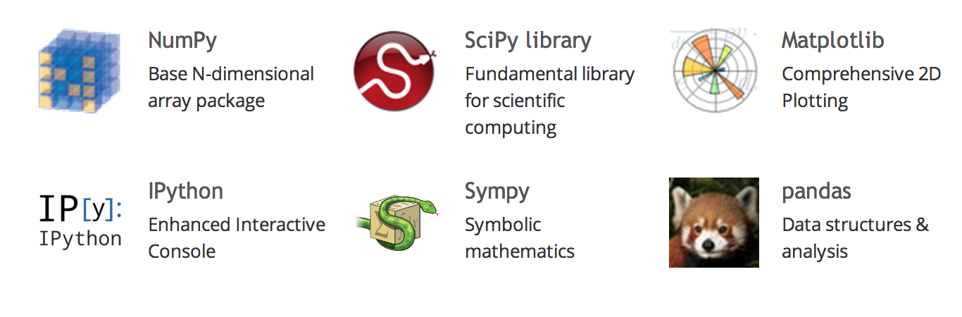
The Scientific Python Ecosystem
The following commonly-used Python modules are a part of an ecosystem referred to as SciPy:

Slide 4
Python Modules and Packages
A module is a group of related code intended to be imported into other Python scripts.
The Python Standard Library is the standard foundation of the language and does not need to be imported into a Python script.
Other reusable code is imported as modules.
Importing a module means importing a single file but that file can import other modules

Slide 5
Python Packages
A package is a collection of Python modules under a common namespace.
Think of packages as folders, and modules as files in a folder.

Slide 6
Numpy
Notes:
COLUMNS:
Student_df.columns
Students.df.GPA
Students_df[‘GPA’]
Students_df[ [‘GPA’,’Name’] ]
ROWS
Students_df[1:2] # slice notation
Student_df.GPA > 3.5 # returns a series of the expression evaluated
# can then be used to filter rows:
Student_df[ Student_df.GPA > 3.5 ]
Can be combined, here’s the names of smart students.
Student_df[ Student_df.GPA > 3.5 ][‘Name’]

Slide 7
What is numpy?
Numpy is the core library for scientific computing in Python.
Provides a high-performance multidimensional array object, and tools for working with these arrays.
Unlike python list, numpy elements must all be the same type
Forcing the same type allows for faster execution
Numpy includes an extensive collection of mathematical operations
Whenever possible, try to use the numpy library over standard python due to efficiency

Slide 8
Numpy Demo
Notes:
COLUMNS:
Student_df.columns
Students.df.GPA
Students_df[‘GPA’]
Students_df[ [‘GPA’,’Name’] ]
ROWS
Students_df[1:2] # slice notation
Student_df.GPA > 3.5 # returns a series of the expression evaluated
# can then be used to filter rows:
Student_df[ Student_df.GPA > 3.5 ]
Can be combined, here’s the names of smart students.
Student_df[ Student_df.GPA > 3.5 ][‘Name’]

Slide 9
Pandas
Notes:
COLUMNS:
Student_df.columns
Students.df.GPA
Students_df[‘GPA’]
Students_df[ [‘GPA’,’Name’] ]
ROWS
Students_df[1:2] # slice notation
Student_df.GPA > 3.5 # returns a series of the expression evaluated
# can then be used to filter rows:
Student_df[ Student_df.GPA > 3.5 ]
Can be combined, here’s the names of smart students.
Student_df[ Student_df.GPA > 3.5 ][‘Name’]

Slide 10
What is pandas ?
pandas is an open-source library with easy-to-use data structures and functions that simplifies data analysis and modeling in Python, including:
DataFrame and Series data structures
Tools for reading and writing data in CSV format, Excel, and SQL databases
“group by” operator on data sets
merging and joining data sets
pandas data structures are used in many other Python libraries, so it is a good library to be familiar with.

Slide 11
What is Pandas Continued
Think of pandas as a cross between an Excel spreadsheet and a database.
Pandas stores data in a two-dimensional grid similar to a spreadsheet
Improves on spreadsheet capability:
Adds robust label capability to rows and columns
Adds powerful functionality similar to a database which allows for complicated querying, filtering, sorting, merging, etc.
Includes all the math capability of a spreadsheet and more

Slide 12
Essential Pandas: Series and DataFrames
Pandas has two data structures
Series → A Labeled list of data,
DataFrame → A dictionary of Series
The DataFrame is a table of data, and the Series represents one column in that table.
NOTE: Pandas is “smart enough” to create a DataFrame from a list of dictionary, too.

Slide 13
Pandas Demo
Notes:
COLUMNS:
Student_df.columns
Students.df.GPA
Students_df[‘GPA’]
Students_df[ [‘GPA’,’Name’] ]
ROWS
Students_df[1:2] # slice notation
Student_df.GPA > 3.5 # returns a series of the expression evaluated
# can then be used to filter rows:
Student_df[ Student_df.GPA > 3.5 ]
Can be combined, here’s the names of smart students.
Student_df[ Student_df.GPA > 3.5 ][‘Name’]

Slide 14
Matplotlib
Notes:
COLUMNS:
Student_df.columns
Students.df.GPA
Students_df[‘GPA’]
Students_df[ [‘GPA’,’Name’] ]
ROWS
Students_df[1:2] # slice notation
Student_df.GPA > 3.5 # returns a series of the expression evaluated
# can then be used to filter rows:
Student_df[ Student_df.GPA > 3.5 ]
Can be combined, here’s the names of smart students.
Student_df[ Student_df.GPA > 3.5 ][‘Name’]

Slide 15
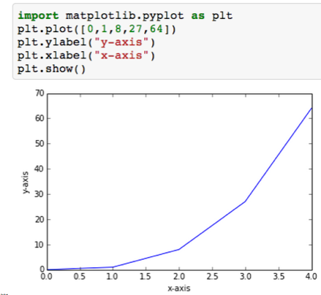
What is Matplotlib
A 2D and 3D plotting library that can be used by Python as well as other frameworks.
Has a large API with functions that can graph just about any plot imaginable.
Notes:
This course uses the functions in matplotlib.pyplot, a collection of functions that plot sequences and arrays easily.

Slide 16
Matplotlib Demo
Notes:
COLUMNS:
Student_df.columns
Students.df.GPA
Students_df[‘GPA’]
Students_df[ [‘GPA’,’Name’] ]
ROWS
Students_df[1:2] # slice notation
Student_df.GPA > 3.5 # returns a series of the expression evaluated
# can then be used to filter rows:
Student_df[ Student_df.GPA > 3.5 ]
Can be combined, here’s the names of smart students.
Student_df[ Student_df.GPA > 3.5 ][‘Name’]

Slide 17
Monte Carlo Simulations
Using Numpy and Matplotlib to calculate pi
Notes:
COLUMNS:
Student_df.columns
Students.df.GPA
Students_df[‘GPA’]
Students_df[ [‘GPA’,’Name’] ]
ROWS
Students_df[1:2] # slice notation
Student_df.GPA > 3.5 # returns a series of the expression evaluated
# can then be used to filter rows:
Student_df[ Student_df.GPA > 3.5 ]
Can be combined, here’s the names of smart students.
Student_df[ Student_df.GPA > 3.5 ][‘Name’]

Slide 18
Monte Carlo Simulation
What is a Monte Carlo simulation: A broad class of computational algorithms that rely on repeated random sampling to obtain numerical results.
Involves the use of randomness to solve deterministic problems.
A deterministic system always produces the same output from a given starting condition or initial state.
https://en.wikipedia.org/wiki/Monte_Carlo_method

Slide 19
Demo: Monte Carlo Simulation to Compute Pi
Notes:
COLUMNS:
Student_df.columns
Students.df.GPA
Students_df[‘GPA’]
Students_df[ [‘GPA’,’Name’] ]
ROWS
Students_df[1:2] # slice notation
Student_df.GPA > 3.5 # returns a series of the expression evaluated
# can then be used to filter rows:
Student_df[ Student_df.GPA > 3.5 ]
Can be combined, here’s the names of smart students.
Student_df[ Student_df.GPA > 3.5 ][‘Name’]

